Slide 1

Group 1
Team Leader: Huda Maqsood
Team Members: Faiza Mukhtar
Yusra Maqsood
Huda Maqsood

Slide 2

ATM (Automated Teller Machine)

Slide 3

ATM stands for Automated Teller Machine which is a self-service banking outlet. You can withdraw money, check your balance, or even transfer funds at an ATM. Different banks provide their ATM services by installing cash machines in different parts of the country. You can withdraw money from any of these machines irrespective of whether or not you are an account holder in the same bank.

Slide 4
Advantages of ATM
Some of the advantages of ATM include:
24/7 access to banking services
Saves time
Increased security
Wide range of banking services
Easy accessibility
Disadvantages of ATM
There are a few drawbacks of ATMs. They are:
Transaction limit
Technical errors
Limited services
Fraud risks
Transaction fees

Slide 5
Types of ATM Automated Teller Machines (ATMs) are mainly of two types. 1. Simple basic unit 2. Complex unit

Slide 6
Simple Basic Unit simple basic unit that allows you to withdraw cash, check your balance, change the PIN, get mini statements and receive account updates.
COMPLEX UNIT
The more complex units provide facilities for cash or cheque deposits and line of credit & bill payments.

Slide 7

balance = 100000000
pin = "5642"
name = "Huda Maqsood"
address = "North Nazimabad, Block T"
contact_info = "hudamaqsood04@gmail.com"
transactions = []
def check_balance():
print("Your balance is ${}".format(balance))
def deposit():
global balance
amount = float(input("Enter amount to deposit: $"))
balance += amount
transactions.append("Deposited ${:.2f}".format(amount))
print("Deposit successful. Your new balance is ${}".format(balance))

Slide 8
def withdraw():
global balance
amount = float(input("Enter amount to withdraw: $"))
if amount > balance:
print("Insufficient funds.")
else:
balance -= amount
transactions.append("Withdrawn ${:.2f}".format(amount))
print("Withdrawal successful. Your new balance is ${}".format(balance))
def transfer():
global balance
amount = float(input("Enter amount to transfer: $"))
if amount > balance:
print("Insufficient funds.")
else:
receiver = input("Enter receiver's account number: ")
transactions.append("Transferred ${:.2f} to account {}".format(amount, receiver))
balance -= amount
print("Transfer of ${:.2f} to account {} successful.".format(amount, receiver))
print("Your new balance is ${}".format(balance))

Slide 9
def change_pin():
global pin
new_pin = input("Enter new PIN: ")
confirm_pin = input("Confirm new PIN: ")
if new_pin == confirm_pin:
pin = new_pin
print("PIN changed successfully.")
else:
print("PINs do not match. PIN not changed.")
def mini_statement():
print("Mini Statement:")
if not transactions:
print("No recent transactions.")
else:
for transaction in transactions:
print(transaction)
print("End of mini statement.")

Slide 10
def loan():
global balance
loan_amount = float(input("Enter loan amount: $"))
balance += loan_amount
transactions.append("Loan of ${:.2f} credited to your account".format(loan_amount))
print("Loan of ${:.2f} successfully credited to your account.".format(loan_amount))
def pay_bill():
global balance
bill_type = input("Enter bill type (e.g., Electricity, Water, Internet): ")
account_number = input("Enter account number: ")
bill_amount = float(input("Enter bill amount: $"))
if bill_amount > balance:
print("Insufficient funds.")
else:
balance -= bill_amount
transactions.append("Bill payment of ${:.2f} made for {} account {}".format(bill_amount, bill_type, account_number))
print("Bill payment of ${:.2f} for {} account {} successful. Your new balance is ${}".format(bill_amount, bill_type, account_number, balance))

Slide 11
def change_language():
language = input("Enter preferred language (e.g., English, Spanish): ")
print("Language changed to", language)
def view_transactions():
print("Recent Transactions:")
if not transactions:
print("No recent transactions.")
else:
for transaction in transactions:
print(transaction)
print("End of recent transactions.")
def add_contact():
contact_name = input("Enter contact name: ")
contact_number = input("Enter contact number: ")
print("Contact '{}' with number '{}' added successfully.".format(contact_name, contact_number))

Slide 12
def check_credit_score():
print("Your credit score is excellent.")
def update_info():
global pin, name, address, contact_info
new_pin = input("Enter new PIN: ")
confirm_pin = input("Confirm new PIN: ")
if new_pin == confirm_pin:
pin = new_pin
name = input("Enter new name: ")
address = input("Enter new address: ")
contact_info = input("Enter new contact information: ")
print("Personal information and PIN updated successfully.")
else:
print("PINs do not match. Personal information and PIN not updated.")

Slide 13
def activate_card():
print("Card activated successfully.")
def block_card():
print("Card blocked successfully.")
def change_alert_settings():
print("Alert settings changed successfully.")
def add_funds():
global balance
amount = float(input("Enter amount to add: $"))
balance += amount
transactions.append("Funds added: ${:.2f}".format(amount))
print("Funds added successfully. Your new balance is ${}".format(balance))

Slide 14
def activate_card():
print("Card activated successfully.")
def block_card():
print("Card blocked successfully.")
def change_alert_settings():
print("Alert settings changed successfully.")
def add_funds():
global balance
amount = float(input("Enter amount to add: $"))
balance += amount
transactions.append("Funds added: ${:.2f}".format(amount))
print("Funds added successfully. Your new balance is ${}".format(balance))
print("Thank you for using this ATM. Goodbye!")
exit()

Slide 15
def atm():
while True:
print("\nATM Menu:")
print("1. Check Balance")
print("2. Deposit")
print("3. Withdraw")
print("4. Transfer")
print("5. Change PIN")
print("6. Mini Statement")
print("7. Loan")
print("8. Pay Bill")
print("9. Change Language")
print("10. View Transactions")
print("11. Add Contact")
print("12. Check Credit Score")
print("13. Update Personal Information")
print("14. Activate Card")
print("15. Block Card")
print("16. Change Alert Settings")
print("17. Add Funds (Prepaid Card)")
print("18. View Offers and Promotions")
print("19. Help and Information")
print("20. Quit")

Slide 16
choice = input("Enter your choice: ")
if choice == '1':
check_balance()
elif choice == '2':
deposit()
elif choice == '3':
withdraw()
elif choice == '4':
transfer()
elif choice == '5':
change_pin()
elif choice == '6':
mini_statement()
elif choice == '7':
loan()
elif choice == '8':
pay_bill()

Slide 17
elif choice == '9':
change_language()
elif choice == '10':
view_transactions()
elif choice == '11':
add_contact()
elif choice == '12':
check_credit_score()
elif choice == '13':
update_info()
elif choice == '14':
activate_card()
elif choice == '15':
block_card()
elif choice == '16':
change_alert_settings()

Slide 18
elif choice == '17':
add_funds()
elif choice == '18':
view_offers()
elif choice == '19':
help_info()
elif choice == '20':
quit_program()
else:
print("Invalid choice. Please enter a valid option.")
if __name__ == "__main__":
atm()

Slide 19

Please Select a transaction
1
CHECK BALANCE
2
CASH DEPOSIT
3
CASH WITHDRAWAL
4
FUNDS TRANSFER
5
PIN CHANGE
6
MIN STATEMENT

Slide 20
SELECT AMOUNT
$ 100
$ 500
$ 1000
$ 5000
OTHER
BACK

Slide 21
Enter Amount
$ 29999

Slide 22
Withdrawal Successful
Your New Balance is $ 99972632.0

Slide 23
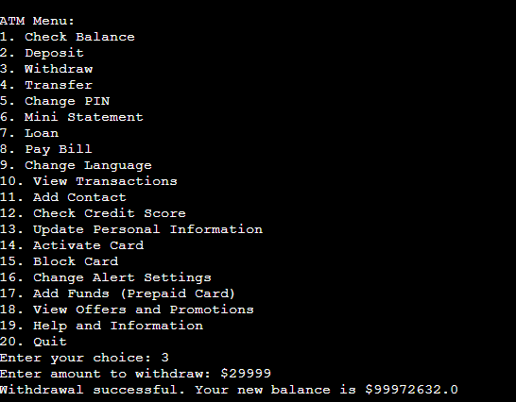

Slide 24
Please Select a transaction
1
CHECK BALANCE
2
CASH DEPOSIT
3
CASH WITHDRAWAL
4
FUNDS TRANSFER
5
PIN CHANGE
6
MINI STATEMENT

Slide 25
SELECT AMOUNT
$ 100
$ 500
$ 1000
$ 5000
OTHER
BACK

Slide 26
Enter Amount
$ 1000000000

Slide 27
INSUFFFICIENT FUND

Slide 28
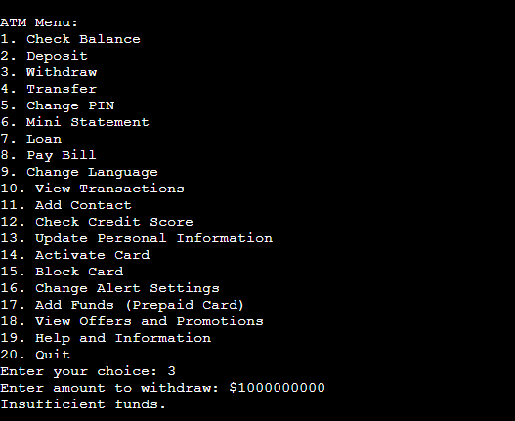

Slide 29
Please Select a transaction
1
CHECK BALANCE
2
CASH DEPOSIT
3
CASH WITHDRAWAL
4
FUNDS TRANSFER
5
CHANGE PIN
6
MINI STATEMENT

Slide 30
Enter Amount
$ 2631

Slide 31
Deposit Successful
Your New Balance is $ 100002631.0

Slide 32
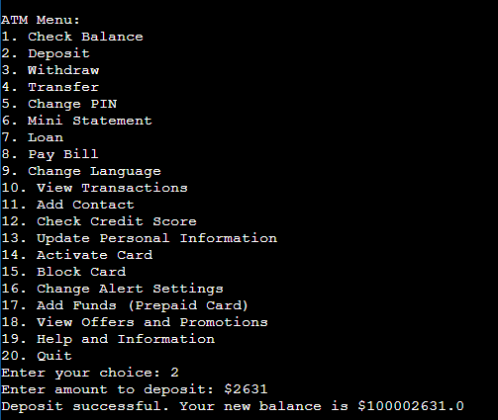

Slide 33
Please Select a transaction
7
LOAN
8
BILL PAYMENT
9
CASH WITHDRAWAL
10
PIN CHANGE
11
BILL PAYMENT
12
FUNDS TRANFER

Slide 34
Please Select a transaction
1
ELECTRICITY
2
WATER
3
INTERNET

Slide 35
Enter Account Number
23486283

Slide 36
Enter Bill Amount
$ 2300000

Slide 37
Bill payment of $2300000.00 for internet account 23486283.
Your new balance is $ 97700000.0

Slide 38
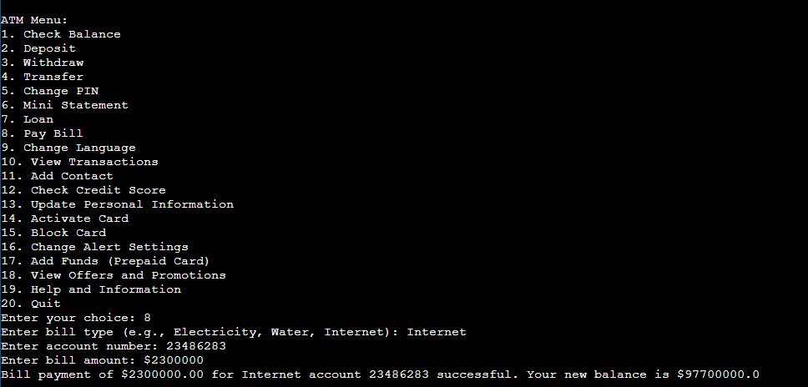

Slide 39
Please Select a transaction
15
BLOCK CARD
16
CHANGE ALLERT SETTING
17
ADD FUNDS (PREPAID CARDS)
18
VIEW OFFERS & POMOTIONS
19
HELP & INFORMATON
20
QUIT

Slide 40
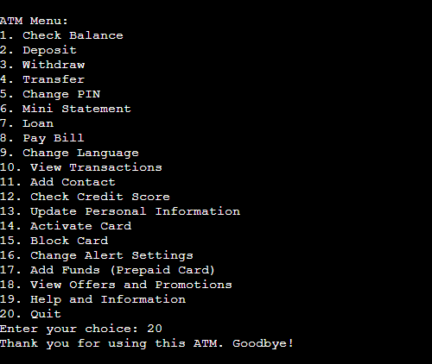

Slide 41
THANK YOU FOR USING ATM
GOOD BYE

